Slide 1
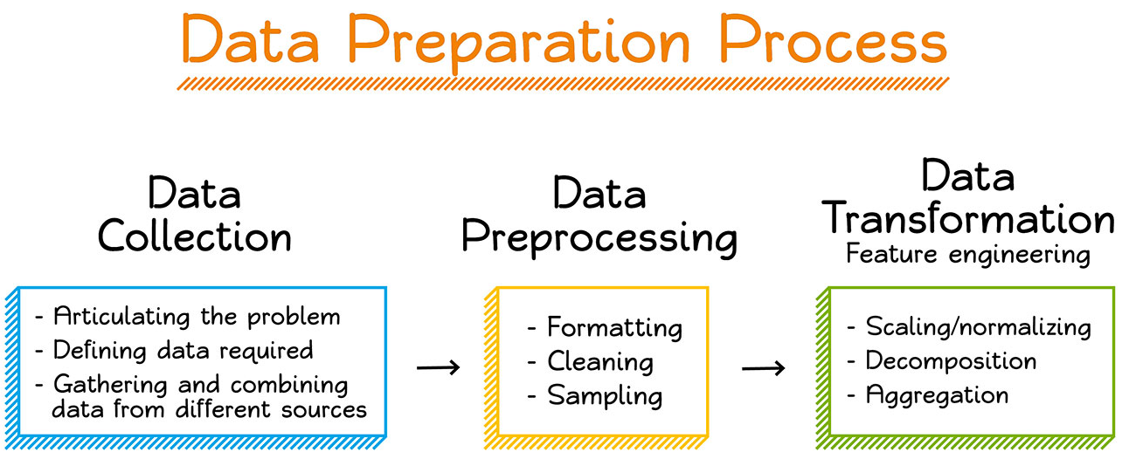
Topics in Module-2-Data Preprocess and EDA
Data Cleaning
Data Integration
Data Transformation
Data Reduction
Significance of Exploratory Data Analysis
Making sense of Data.

Slide 2
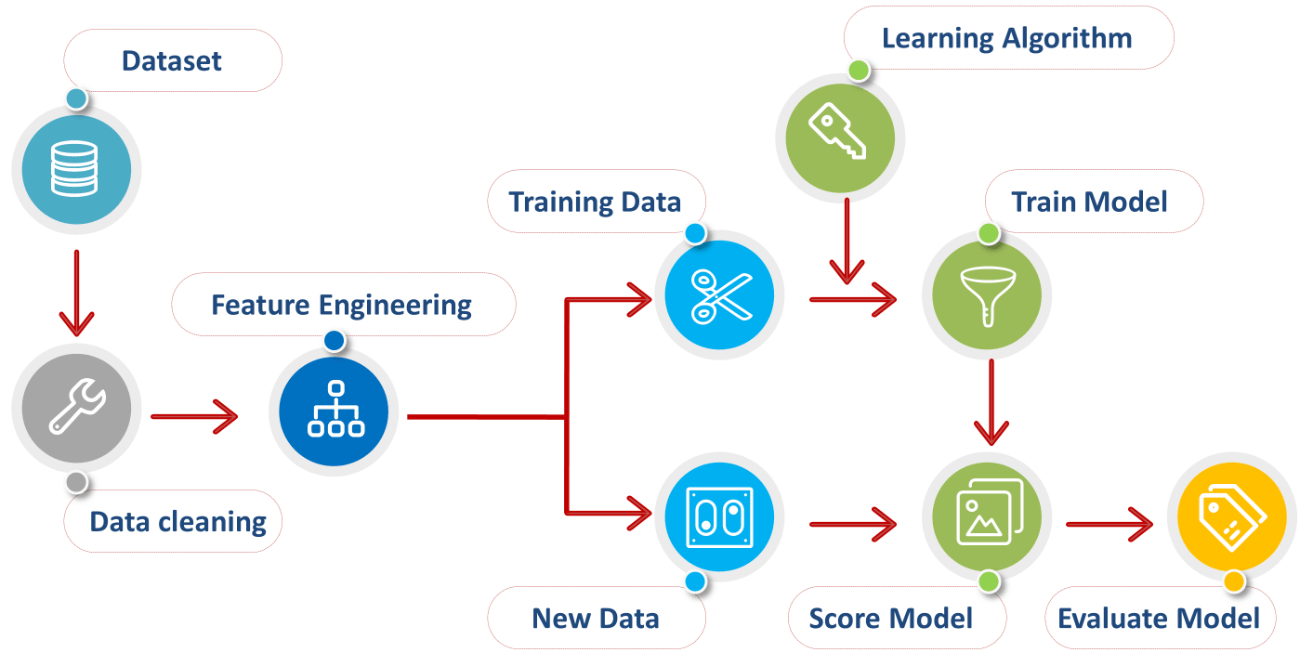
What is Data preprocessing?
Data preprocessing is a process of preparing the raw data and making it suitable for a machine learning model.
Whenever the data is gathered from different sources it is collected in raw format which is not feasible for the analysis.

Slide 3
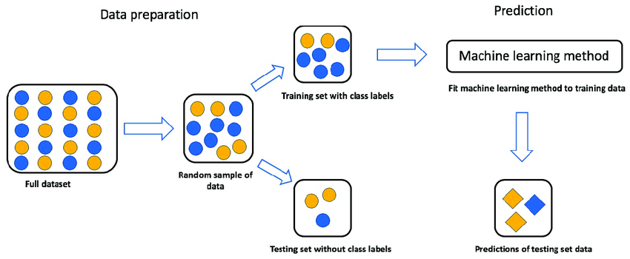
What is Data preprocessing?
A technique of preparing (cleaning and organizing) the raw data to make it suitable for a building and training Machine Learning models.
Any type of processing performed on raw data to prepare it for another data processing procedure.

Slide 4
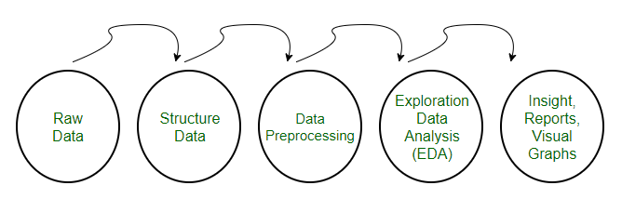
Need for Data preprocessing?
For achieving better results from the applied model in Machine Learning projects the format of the data has to be in a proper manner.
Some specified Machine Learning model needs information in a specified format, for example, Random Forest algorithm does not support null values, therefore to execute random forest algorithm null values have to be managed from the original raw data set.
Another aspect is that the data set should be formatted in such a way that more than one Machine Learning and Deep Learning algorithm are executed in one data set, and best out of them is chosen.

Slide 5
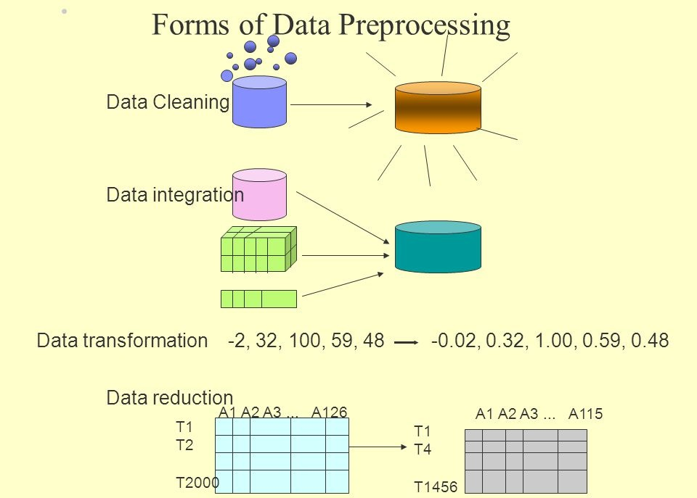
Forms of Data preprocessing

Slide 6
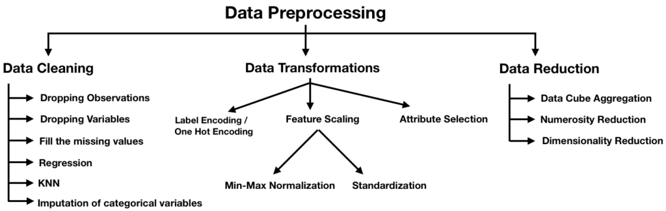
Forms of Data preprocessing
Missing Data
Noisy Data

Slide 7
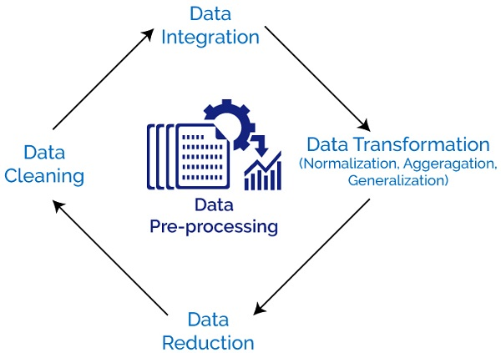
Sequence of Data preprocessing

Slide 8
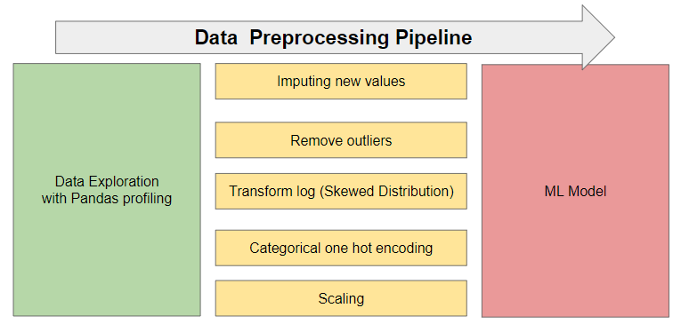
Effective Data preprocessing for a ML model

Slide 9
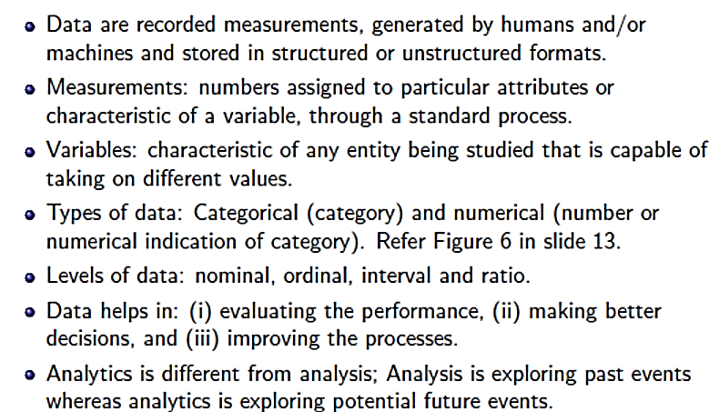
Data and related definitions

Slide 10
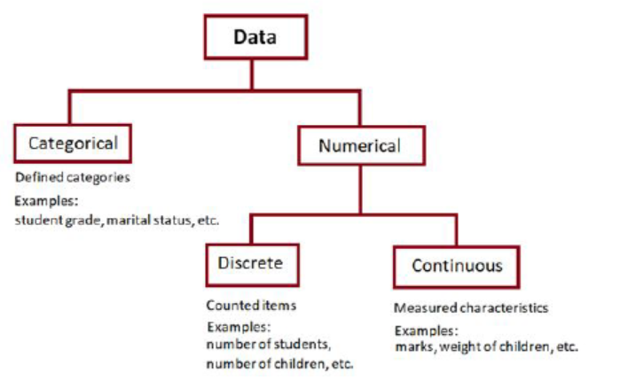
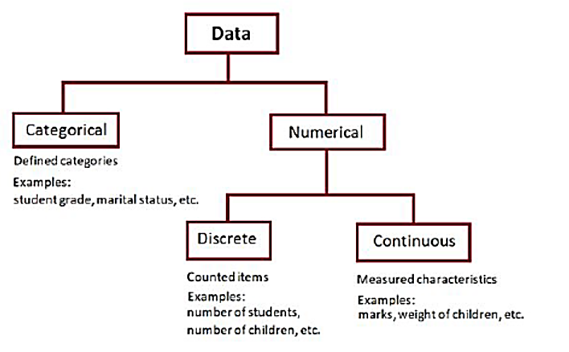
Data and related definitions
Categories of Data

Slide 11
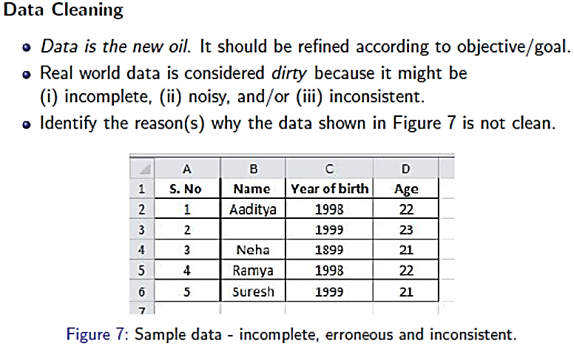
Data Cleaning

Slide 12
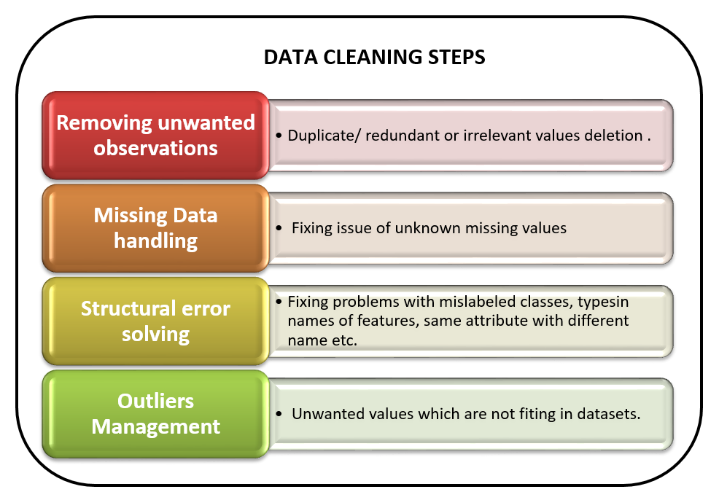
Data Cleaning

Slide 13
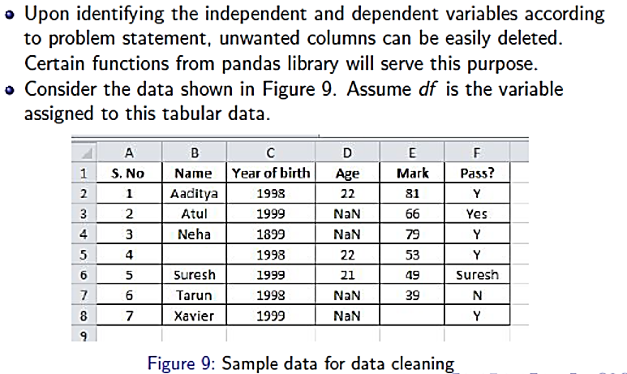
Data Cleaning

Slide 14
Data Cleaning-Missing Data
Data is not always available
E.g., many tuples have no recorded value for several attributes, such as customer income in sales data
Missing data may be due to
equipment malfunction
inconsistent with other recorded data and thus deleted
data not entered due to misunderstanding
certain data may not be considered important at the time of entry
not register history or changes of the data
Missing data may need to be inferred

Slide 15
Data Cleaning-How to handle missing data?
Ignore the tuple: usually done when class label is missing (assuming the task is classification—not effective in certain cases)
Fill in the missing value manually: tedious + infeasible?
Use a global constant to fill in the missing value: e.g., “unknown”, a new class?!
Use the attribute mean to fill in the missing value
Use the attribute mean for all samples of the same class to fill in the missing value: smarter
Use the most probable value to fill in the missing value: inference-based such as regression, Bayesian formula, decision tree

Slide 16
Data Cleaning-How to handle missing data?
Ignore the tuple(store multiple items in a single variable ): usually done when class label is missing (assuming the task is classification—not effective in certain cases)
Fill in the missing value manually: tedious + infeasible?
Use a global constant to fill in the missing value: e.g., “unknown”, a new class?!
Use the attribute mean to fill in the missing value
Use the attribute mean for all samples of the same class to fill in the missing value: smarter
Use the most probable value to fill in the missing value: inference-based such as regression, Bayesian formula, decision tree

Slide 17
Data Cleaning-Noisy data?
Random error in a measured variable.
Incorrect attribute values may be due to
faulty data collection instruments
data entry problems
data transmission problems
technology limitation
inconsistency in naming convention
Other data problems which requires data cleaning
duplicate records
incomplete data
inconsistent data

Slide 18
Data Cleaning-How to handle Noisy data?
Binning method: (Bins- Smallest unit of space inside a database)
first sort data and partition into (equi-depth) bins
then one can smooth by bin means, smooth by bin median, smooth by bin boundaries, etc.
used also for discretization
Clustering
detect and remove outliers
Semi-automated method: combined computer and human inspection
detect suspicious values and check manually
Regression
smooth by fitting the data into regression functions

Slide 19
Data Cleaning-How to handle Inconsistent data?
Manual correction using external references
Semi-automatic using various tools
To detect violation of known functional dependencies and data constraints
To correct redundant data

Slide 20
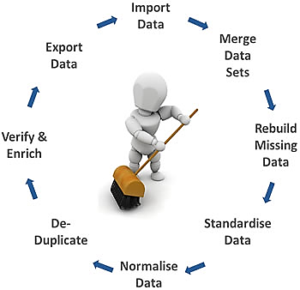
Data Cleaning
Step 1: Remove duplicate or irrelevant observations. Remove unwanted observations from your dataset, including duplicate observations or irrelevant observations. ...
Step 2: Fix structural errors. ...
Step 3: Filter unwanted outliers. ...
Step 4: Handle missing data. ...
Step 5: Validate and QA.

Slide 21
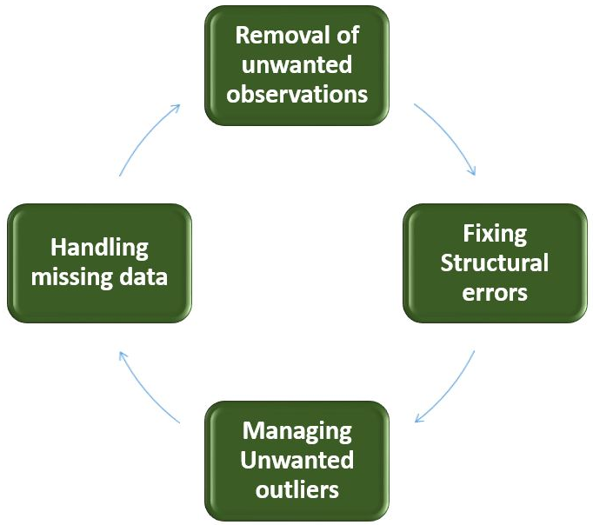
Data Cleaning-Benefits
Removal of errors when multiple sources of data.
Ability to map the different functions and what your data is intended to do.
Monitoring errors and better reporting to see where errors are coming from, making it easier to fix incorrect or corrupt data for future applications.
Using tools for data cleaning will make for more efficient business practices and quicker decision-making.

Slide 22
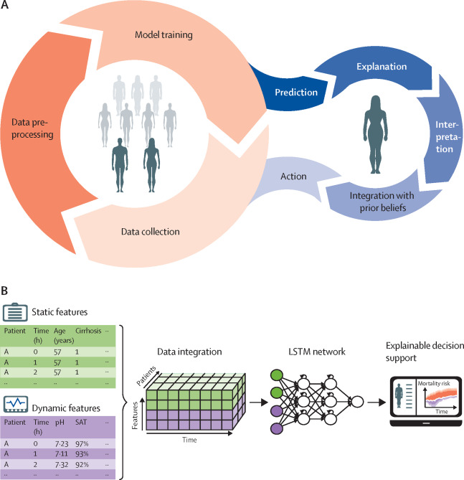
Data Integration
Data integration: combines data from multiple sources into a coherent store
Schema integration:
Integrate metadata from different sources
Entity identification problem: identify real world entities from multiple data sources

Slide 23
Data Integration
Detecting and resolving data value conflicts
for the same real world entity, attribute values from different sources are different
possible reasons: different representations, different scales, e.g., metric vs. British units, different currency

Slide 24
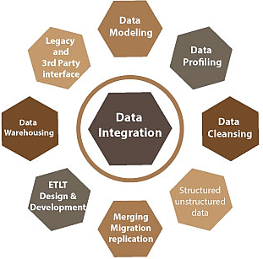
Why Data Integration is important?
Gathering enormous volumes of data from various sources needs to be meaningful.
Ease of accessible for analysis, when fresh data enters the database every second.
Integrated data unlocks a layer of connectivity thereby improving the productivity.
By connecting systems that contain valuable data and integrating them, ease of achieve data continuity and seamless knowledge transfer can be achieved.

Slide 25
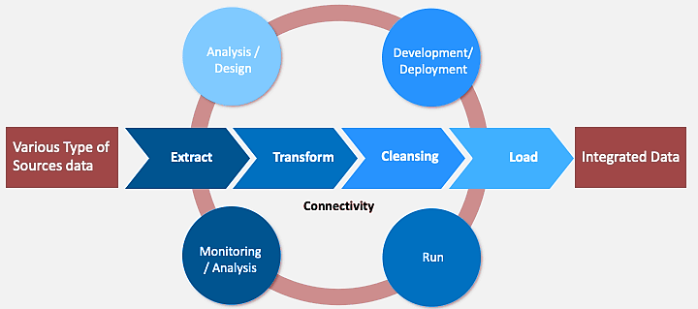
Data Integration

Slide 26
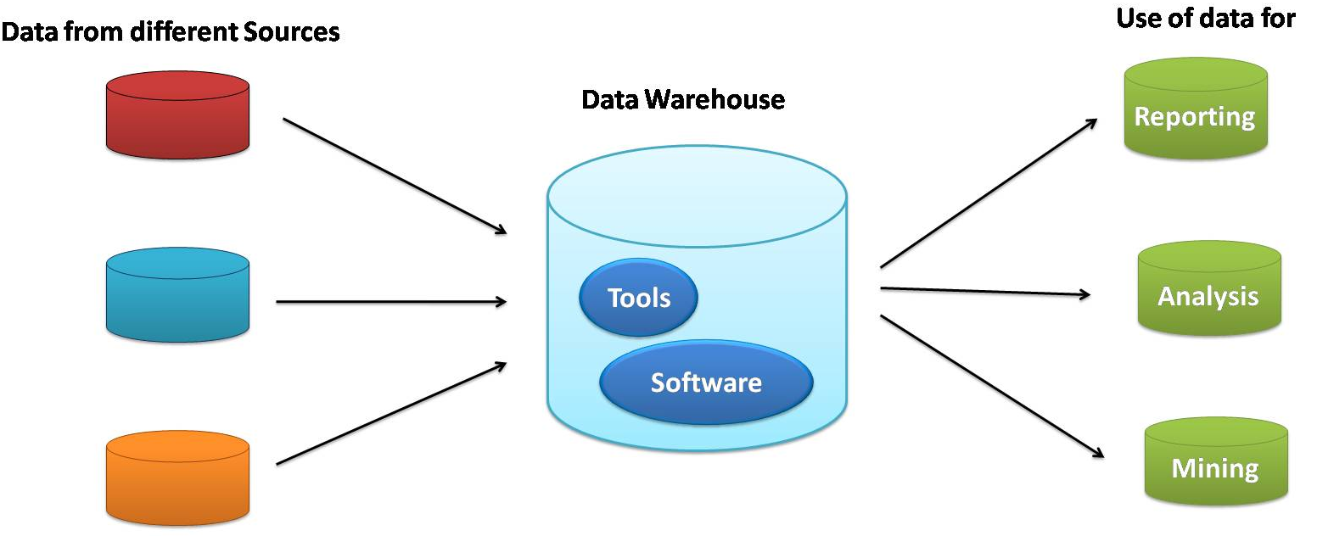
Ways to create Data Integration
Creating a data warehouse: Data warehouses allow you to integrate different sources of data into a master relational database.
When critical data is collected, stored and easily available, it’s much easier to assess micro and macro processes, manage operations and make strategic decisions based on this business intelligence.

Slide 27
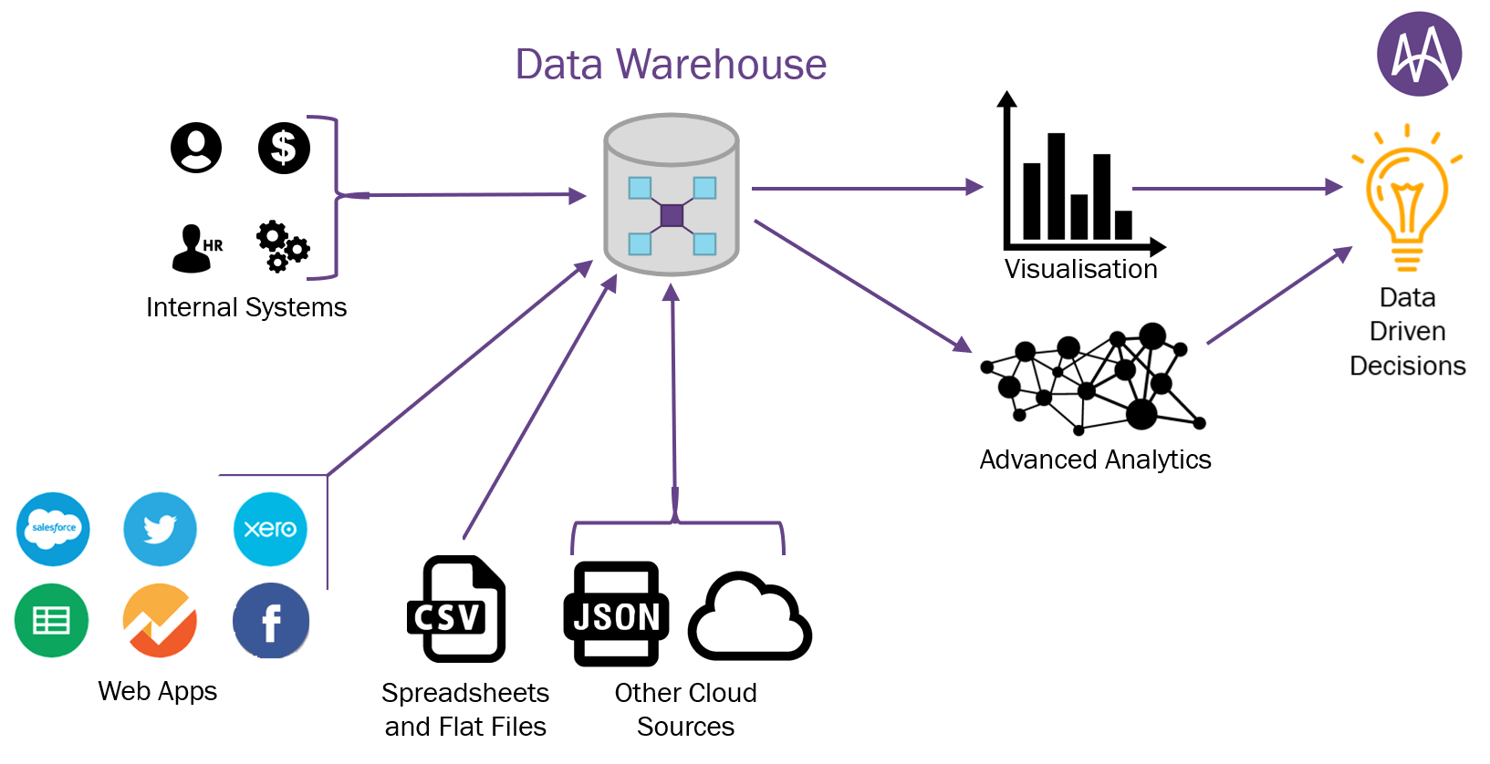
Ways to create Data Integration
In this case, data integration works by providing a cohesive and centralized look at the entirety of an organization’s information, streamlining the process of gaining business intelligence insights.
To achieve this, the managed service provider would a process called ETL.

Slide 28
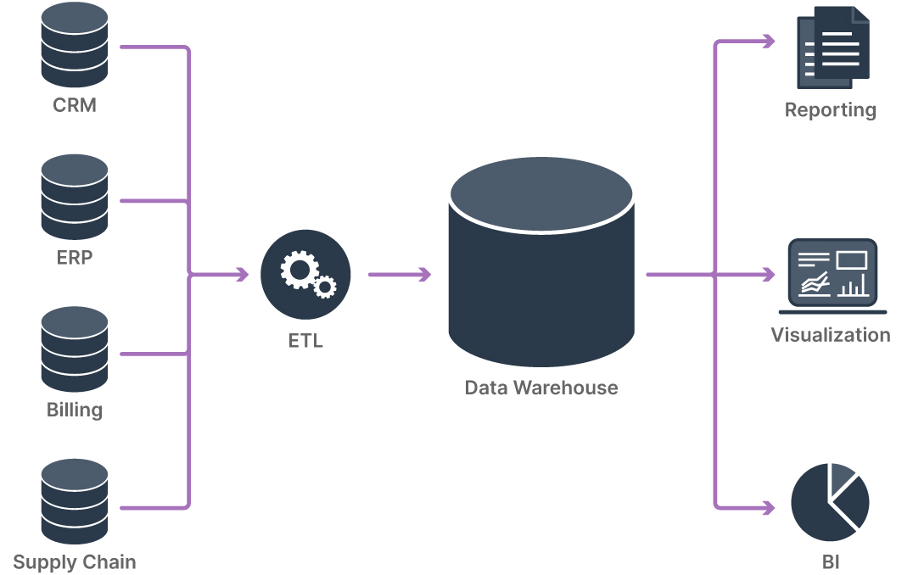
Ways to create Data Integration
In this case, data integration works by providing a cohesive and centralized look at the entirety of an organization’s information, streamlining the process of gaining business intelligence insights.
To achieve this, the managed service provider would a process called ETL.

Slide 29
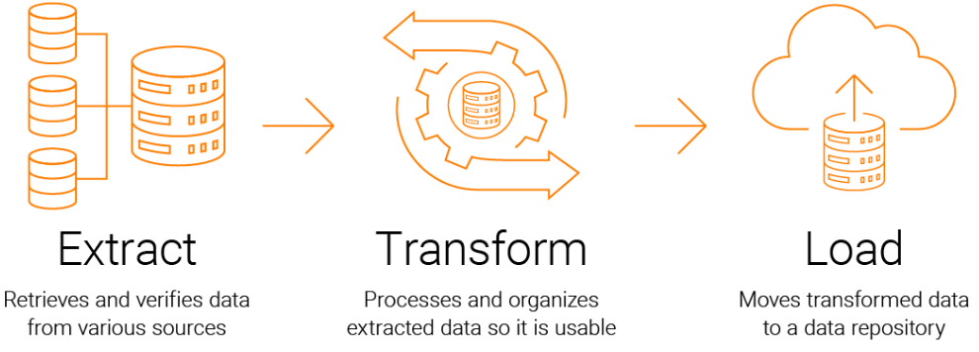
Ways to create Data Integration
ETL (Extract, Transform, Load): ETL is the process of sending data from source systems an organization possesses to the data warehouse where this information will be viewed and used.
Most data integration systems involve one or more ETL pipelines, which make data integration easier, simpler, and quicker.

Slide 30
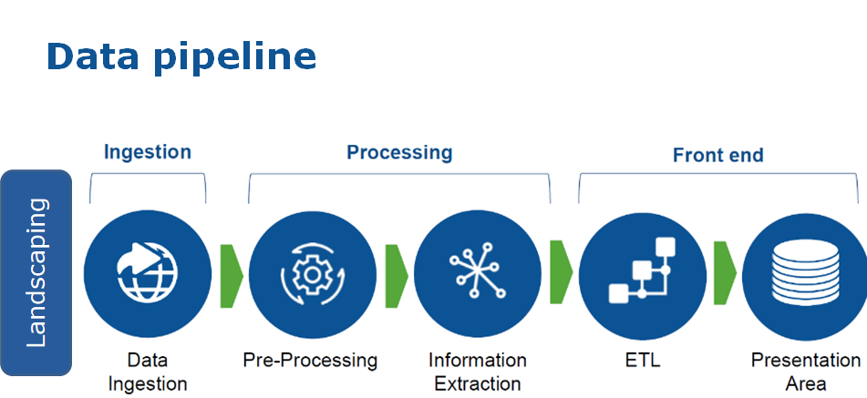
Ways to create Data Integration
Building Data Pipelines:
Avariety of built-in data connectors (for data ingestion), pre-defined transformations, and built-in job scheduler for automating the ETL pipeline.
Such tools make data integration easier, faster, and more cost effective by reducing the dependency on human expertise for manual operation.

Slide 31
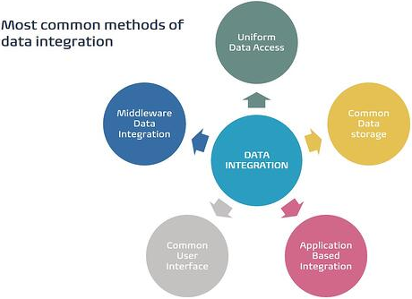
Different types of Data Integration methods
Uniform Data Access:
With Uniform Data Access, enterprise data can be accessed from very disparate sets and present it uniformly.
Uniform Data Access does this while allowing the data to stay in its original location.
It leaves the data in the source system and defines a set that can provide a unified view to various customers across a platform.
There is zero latency from the source system to the consolidated view.

Slide 32
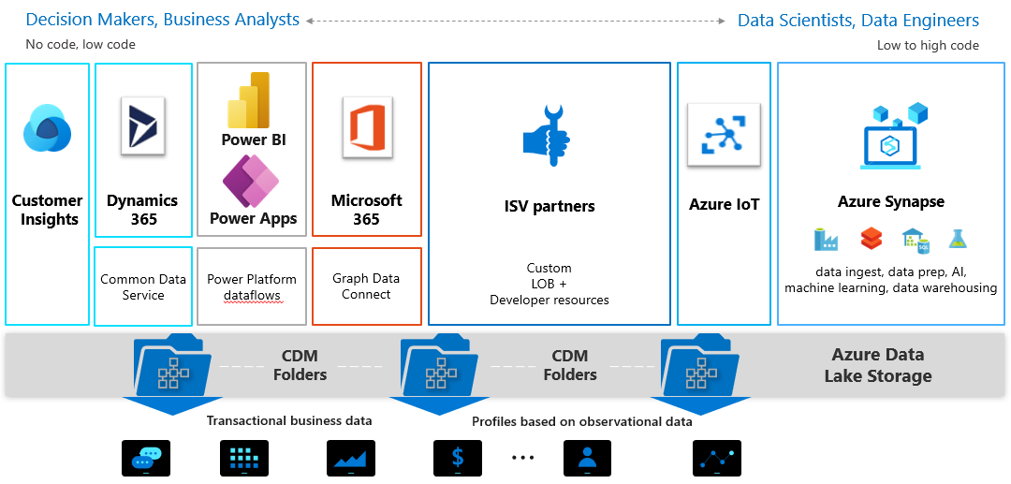
Different types of Data Integration methods
Common Data storage:
Common Data Storage (or CDS or Data Warehouse) is a storage space that enables you to manage and securely store data used by multiple applications or programs.
Helps collecting data from various sources, combining them to a central space and management (Database files, mainframes, and flat files).

Slide 33
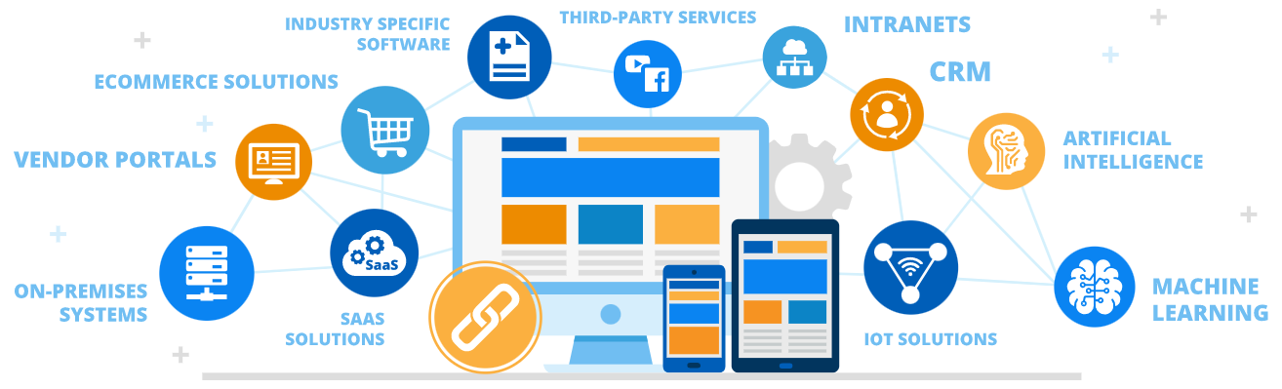
Different types of Data Integration methods
Application based Integration:
Application Based Integration solutions are specialized programs that locate, retrieve and integrate your data.
Application Based Integration accesses various data sources and returns integrated results to the user.
It has limitations if you are handling large volumes of data and large numbers of sources because it requires the applications to implement all the integration efforts.

Slide 34
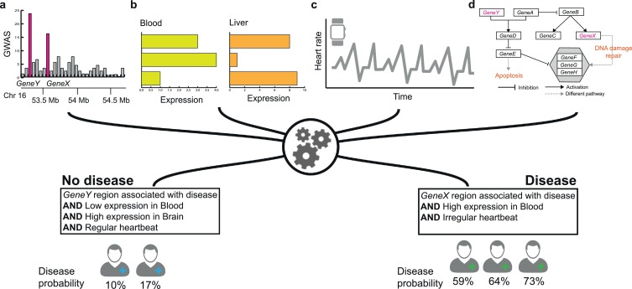
Different types of Data Integration methods
Common User Interface: Common User Interface means manually locating the information in each data source and comparing or cross-referencing them yourself in order to get the insight you need.
The users must deal with different user interfaces and query languages and therefore need to have detailed knowledge on location, logical data representation, and data semantics.
An example for Common User Interface

Slide 35

Different types of Data Integration methods
Middle ware Data integration:
Middleware is a layer of software that creates a common platform for all interactions internal and external to the organization—system-to-system, system-to-database, human-to-system, web-based, and mobile-device-based interactions.
Middleware integration refers to applications that connect two or more applications.

Slide 36
Handling redundant data in Data Integration
Redundant data occur often when integrating multiple DBs
The same attribute may have different names in different databases
One attribute may be a “derived” attribute in another table, e.g., annual revenue
Redundant data may be able to be detected by correlational analysis
Careful integration can help reduce/avoid redundancies and inconsistencies and improve mining speed and quality

Slide 37
Advantages of Data Integration
Elimination of errors
Saves time
Better sense of all the available information.
Streamline the processes and improve the efficacy of data usage.
Inter-system cooperation
Seamless knowledge transfer between systems.
Data integrity and data quality.

Slide 38
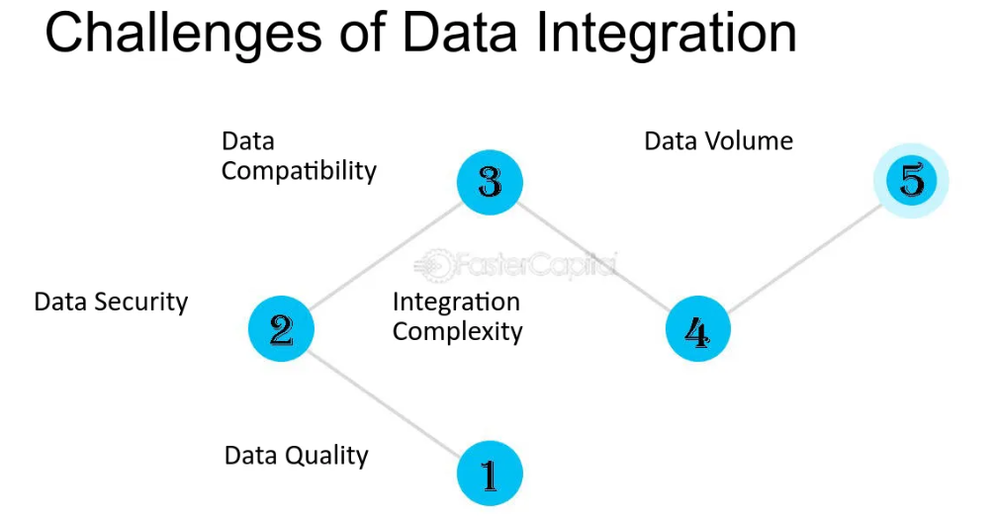
Five challenges and its solution of Data Integration
Solution to challenges:
Clean up your data
Introduce clear processes for data management
Back up your data
Choose the right software to assist you with data integration
Manage and maintain your data

Slide 39
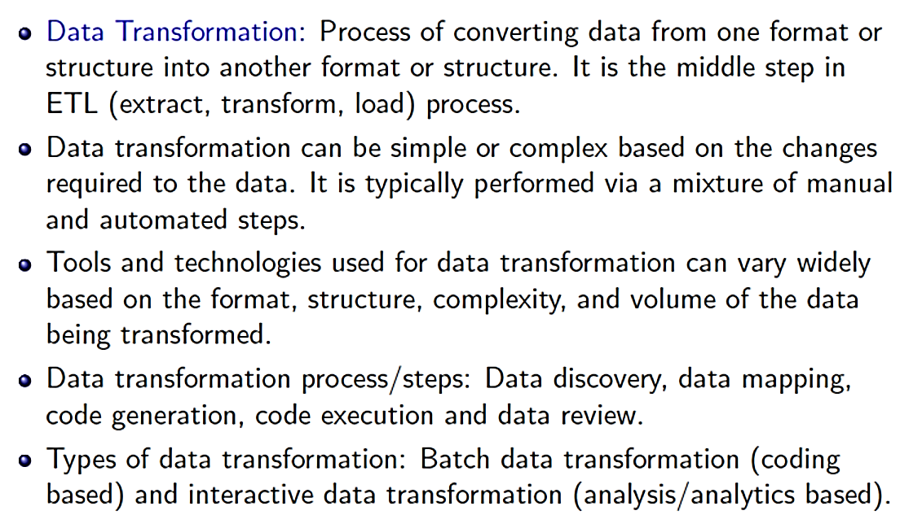
Data Transformation

Slide 40
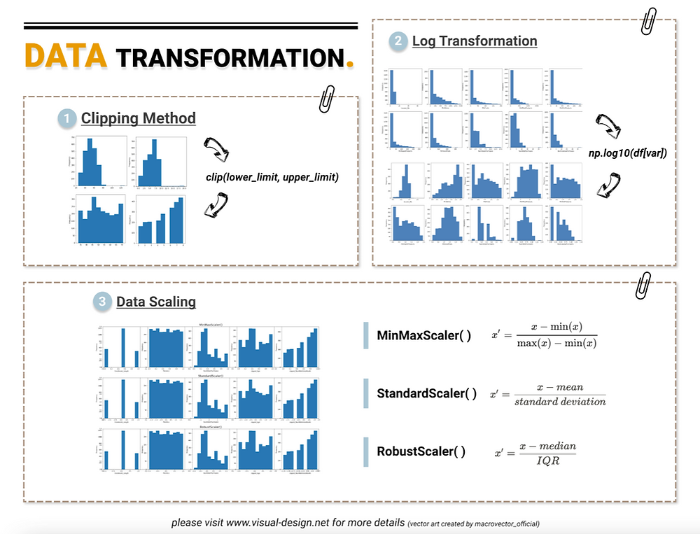
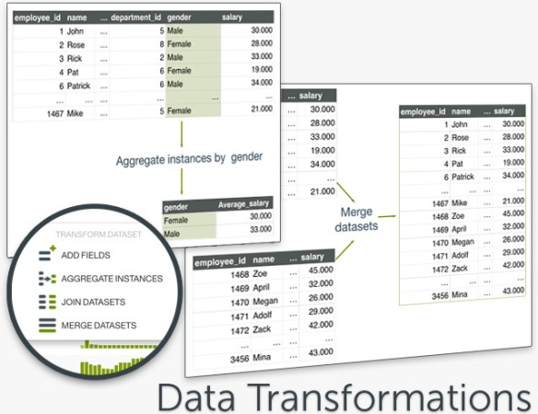
Data Transformation
Smoothing: Remove noise from data (binning, clustering, regression)
Aggregation: Summarization, data cube construction
Generalization: Concept hierarchy climbing(Given a large set of inputs and a good heuristic function, it tries to find a sufficiently good solution to the problem.)

Slide 41
Data Transformation
Normalization: Scaled to fall within a small, specified range
min-max normalization
z-score normalization
normalization by decimal scaling
Attribute/feature construction
New attributes constructed from the given ones

Slide 42
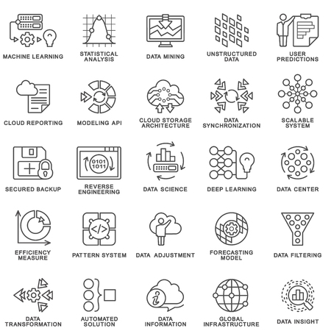
Uses of Data Transformation

Slide 43
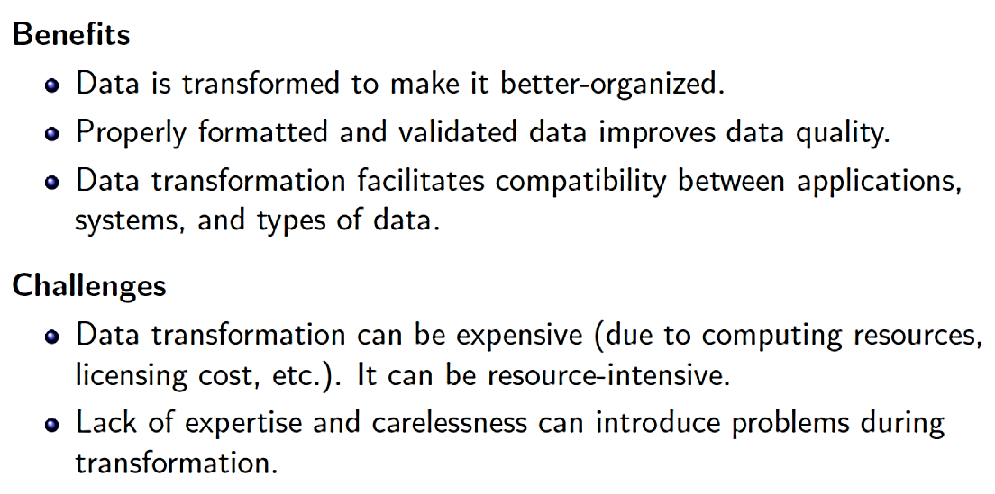
Data Transformation

Slide 44
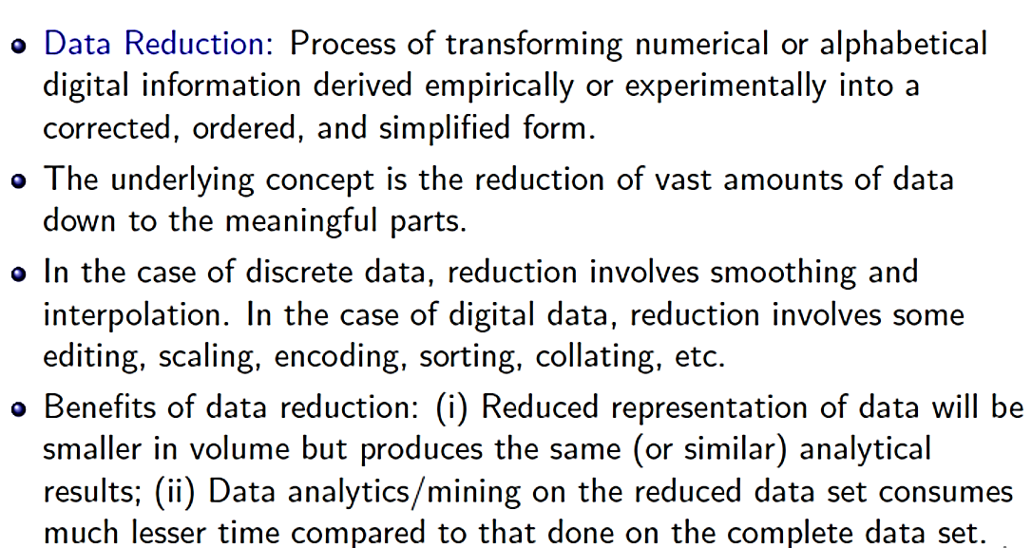
Data Reduction

Slide 45
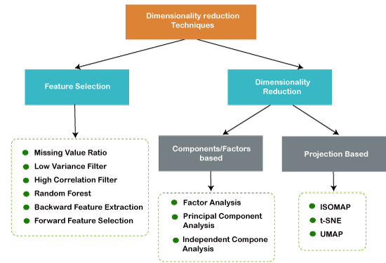
Data Reduction-Types

Slide 46
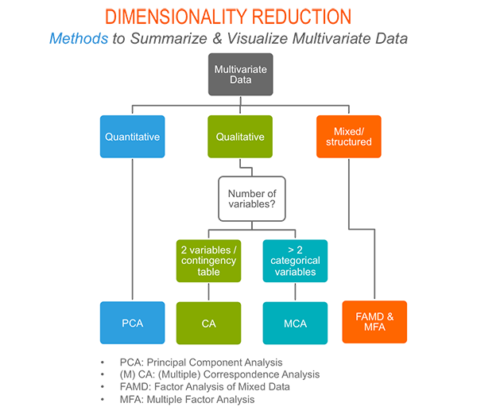
Data Reduction-Types

Slide 47
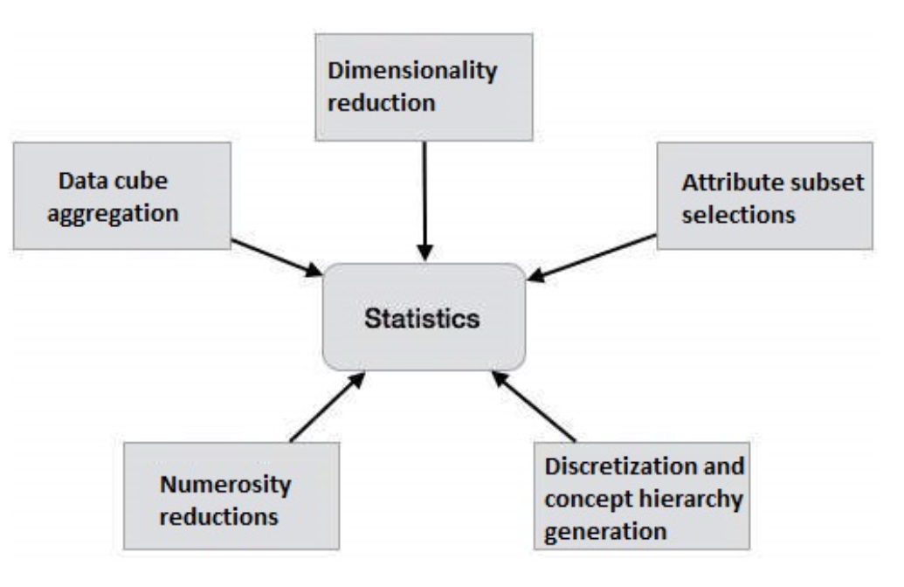
Data Reduction-Strategies
Data cube aggregation- Aggregation operations are applied to the data in the construction of a data cube.
Attribute subset selections- Irrelevant, weakly relevant or redundant attributes or dimensions may be detected and removed.
Dimensionality reduction- Encoding mechanism are used to reduce the data set size.
Numerosity reductions- Data are replaced or estimated by alternative, smaller data representations such as parametric models or non parametric method such as clustering, sampling, and the use of histograms.
Discretization and concept hierarchy generation- Raw data values for attributes are replaced by range or higher conceptual levels.

Slide 48
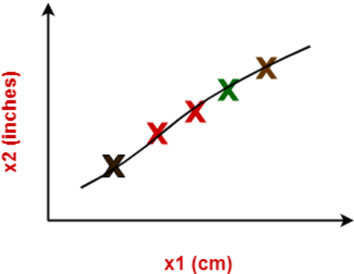
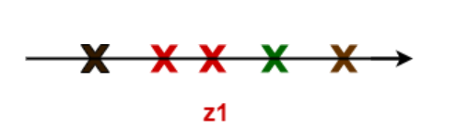
Principal Component Analysis (PCA)
Dimension Reduction is defined as-
It is a process of converting a data set having vast dimensions into a data set with lesser dimensions.
It ensures that the converted data set conveys similar information concisely.
In machine learning,
Using both these dimensions convey similar information. Also, they introduce a lot of noise in the system.
So, it is better to use just one dimension.
Using dimension reduction techniques-
We convert the dimensions of data from 2 dimensions (x1 and x2) to 1 dimension (z1).
It makes the data relatively easier to explain.

Slide 49
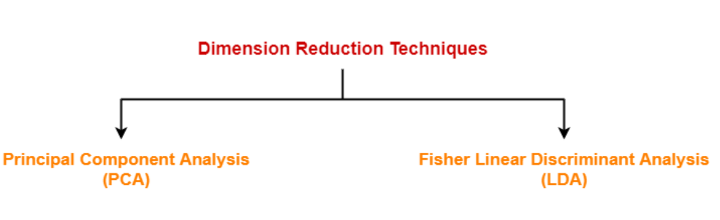
Principal Component Analysis (PCA)
Benefits of Dimension reduction:
It reduces the time required for computation since less dimensions require less computation.
It eliminates the redundant features.
It improves the model performance.
It compresses the data and thus reduces the storage space requirements.

Slide 50
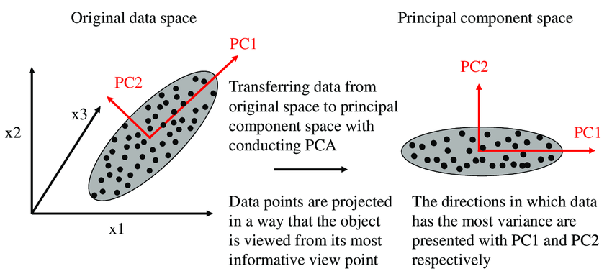
Principal Component Analysis (PCA)
Principal Component Analysis transforms the variables into a new set of variables called as principal components.
Principal components are linear combination of original variables and are orthogonal.
The first principal component accounts for most of the possible variation of original data.
The second principal component does its best to capture the variance in the data.
There can be only two principal components for a two-dimensional data set.

Slide 51
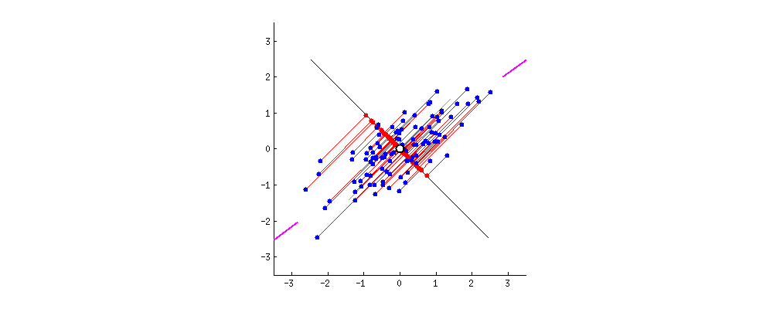
Principal Component Analysis (PCA)
The steps involved in PCA Algorithm are as follows-
Step-01: Get data.
Step-02: Compute the mean vector (µ).
Step-03: Subtract mean from the given data.
Step-04: Calculate the covariance matrix.
Step-05: Calculate the eigen vectors and eigen values of the covariance matrix.
Step-06: Choosing components and forming a feature vector.
Step-07: Deriving the new data set.

Slide 52
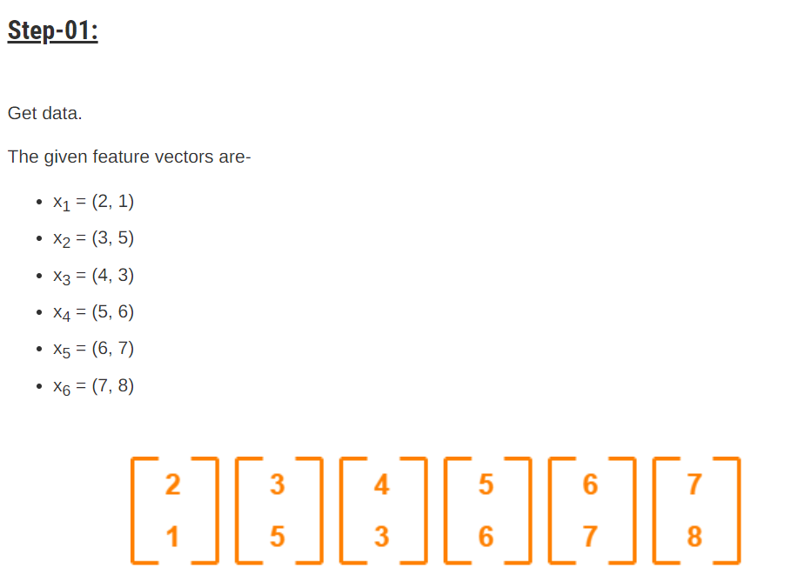
Principal Component Analysis (PCA)#Solved Example-1
Consider the two dimensional patterns (2, 1), (3, 5), (4, 3), (5, 6), (6, 7), (7, 8).
Compute the principal component using PCA Algorithm.
Get data.

Slide 53
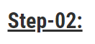
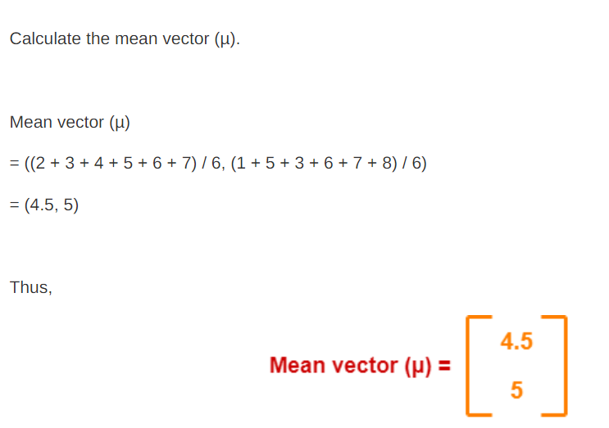
Principal Component Analysis (PCA)#Solved Example-1

Slide 54
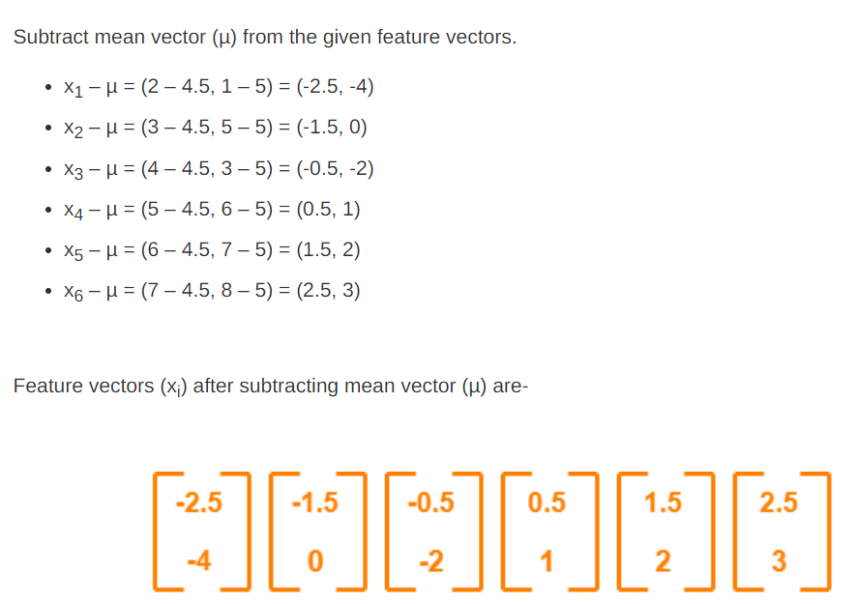

Principal Component Analysis (PCA)#Solved Example-1

Slide 55
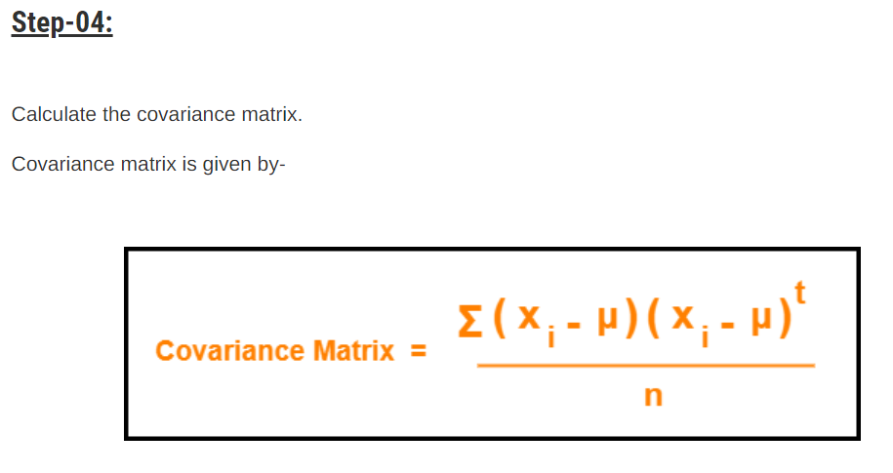
Principal Component Analysis (PCA)#Solved Example-1

Slide 56
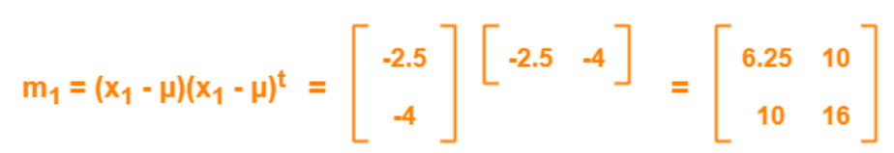
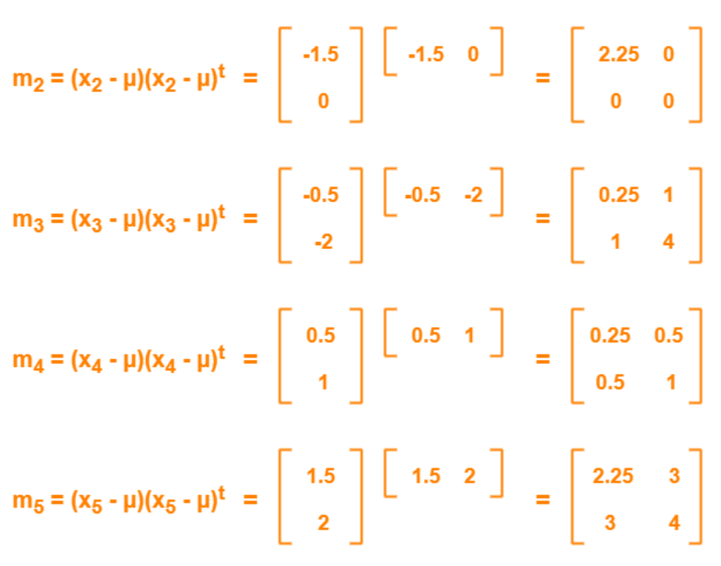

Principal Component Analysis (PCA)#Solved Example-1

Slide 57

Principal Component Analysis (PCA)#Solved Example-1

Slide 58




Principal Component Analysis (PCA)#Solved Example-1

Slide 59
Principal Component Analysis (PCA)#Solved Example-1

Slide 60





Principal Component Analysis (PCA)#Solved Example-1

Slide 61
Principal Component Analysis (PCA)#Solved Example-1

Slide 62


Principal Component Analysis (PCA)#Solved Example-2
Use PCA Algorithm to transform the pattern (2, 1) onto the eigen vector in the previous question.

Slide 63

Principal Component Analysis (PCA)-Summary

Slide 64


Significance of Exploratory Data Analysis (EDA)
Exploratory Data Analysis provides the context needed to develop an appropriate model – and interpret the results correctly.
The purpose of Exploratory Data Analysis is essential to tackle specific tasks such as:
Spotting missing and erroneous data
Mapping and understanding the underlying structure of your data
Identifying the most important variables in your dataset
Testing a hypothesis or checking assumptions related to a specific model
Establishing a parsimonious model (one that can explain your data using minimum variables)

Slide 65

How important Exploratory Data Analysis (EDA)

Slide 66

Making sense of Data
5 characteristics of quality data
Importance of quality data
Validity. The degree to which your data conforms to defined rules or constraints.
Accuracy. Ensure your data is close to the true values.
Completeness. The degree to which all required data is known.
Consistency. Ensure your data is consistent within the same dataset and/or across multiple data sets.
Uniformity. The degree to which the data is specified using the same unit of measure.

Slide 67

Making sense of Data

Slide 68

Making sense of Data
Use Case and Examples

